Slide 1
Gating System
Lecture 4

Slide 2
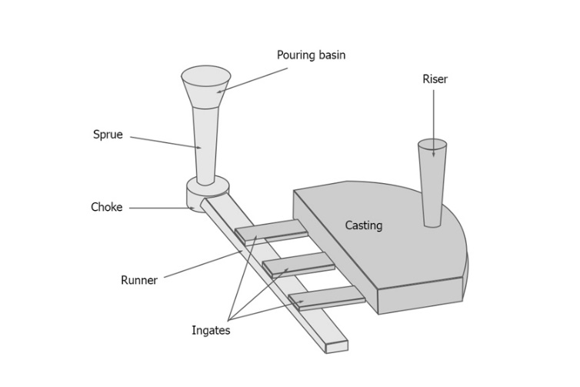
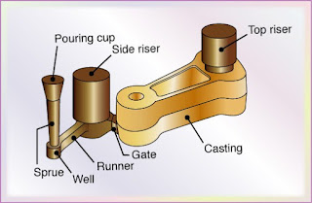
Gating System parts

Slide 3
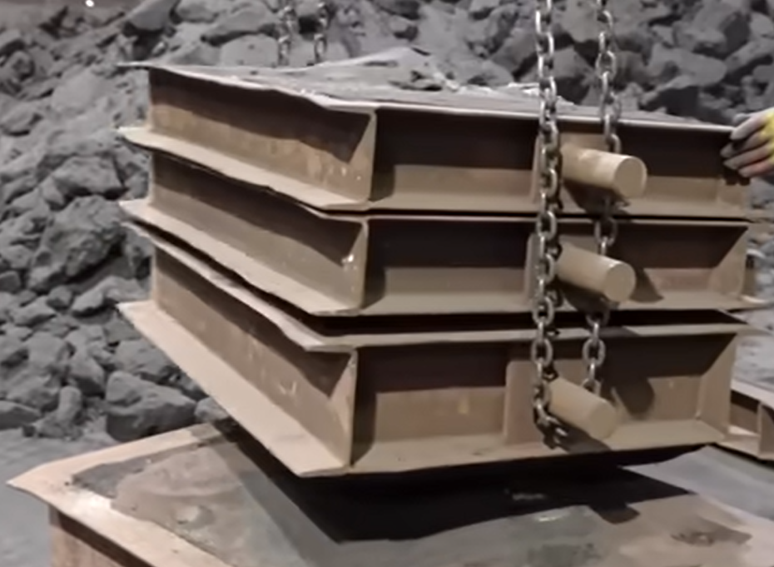
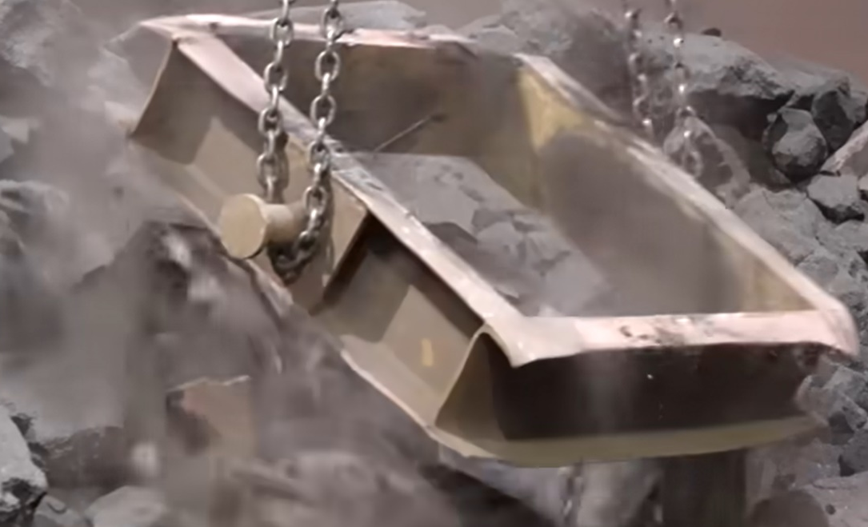
Mold Collapsing

Slide 4
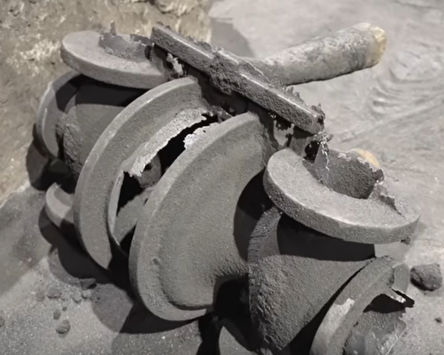
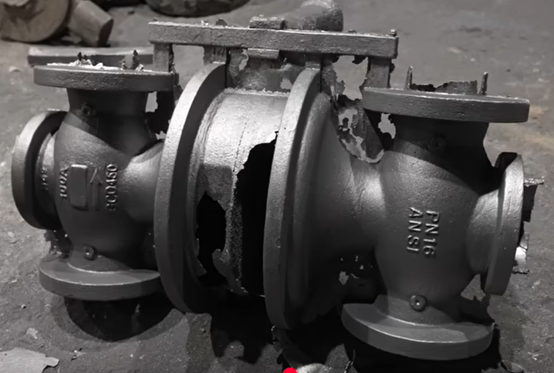
Casting obtained after mold collapsing
Cleaned casting
Raw casting

Slide 5
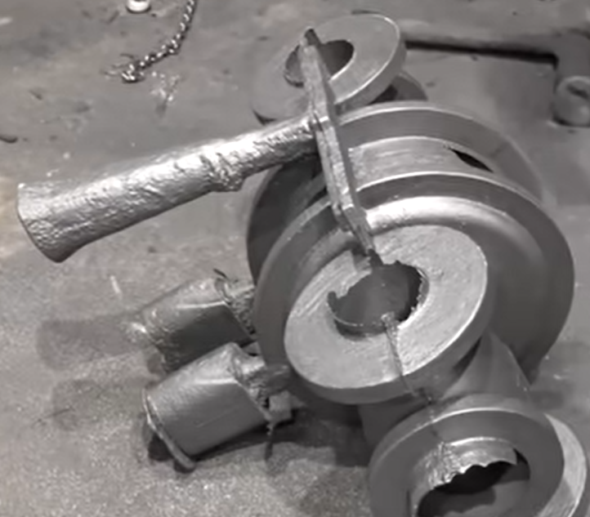
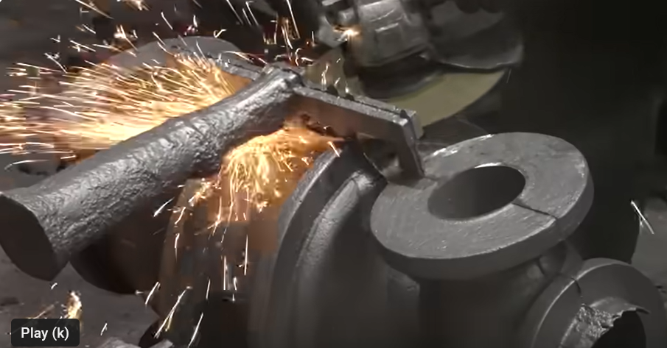
Green Sand Molding Steps
Removal of gates and riser from Casting
Casting with gates and riser

Slide 6
Gating System
A gate is a specific part of the gating system, acting as the entry point for molten metal into the mold cavity.
It's designed to control the flow rate and direction of the molten metal as it enters the mold.
Gates can be designed in various shapes and sizes, depending on the casting process, material, and desired part characteristics.
The gate's design and placement are crucial for achieving a sound and defect-free casting.

Slide 7
Requirements of Gating System
A good gating design should ensure proper distribution of molten metal without excessive temperature loss, turbulence, gas entrapping and slags.
Slow pouring will increase filling time that leads to premature solidification. Hence, super heating of metal is required, but this may cause solubility.
Faster pouring of molten metal cause erosion of the mould cavity.
Therefore, gating design is important and it depends on the metal and molten metal composition. For example, aluminium can get oxidized easily.

Slide 8
Functions of gating system
• Controlling flow: Gates regulate the rate at which molten metal enters the mold cavity, preventing turbulence and ensuring a smooth, consistent flow.
• Minimizing defects: By controlling the flow, gates help prevent issues like air entrapment, shrinkage, and porosity, which can lead to defects in the final casting.
• Directing metal flow: Gates can be strategically placed to guide the molten metal to specific areas of the mold, ensuring proper filling of complex shapes.
• Shrinkage control: In some cases, gates are designed to act as risers, providing a reservoir of molten metal to compensate for shrinkage during solidification.

Slide 9
Aspiration effect
Aspiration effect: entering of gases from baking of organic compounds present in the mould into the molten metal stream. This will produce porous castings. Pressure anywhere in the liquid stream should not become negative.

Slide 10
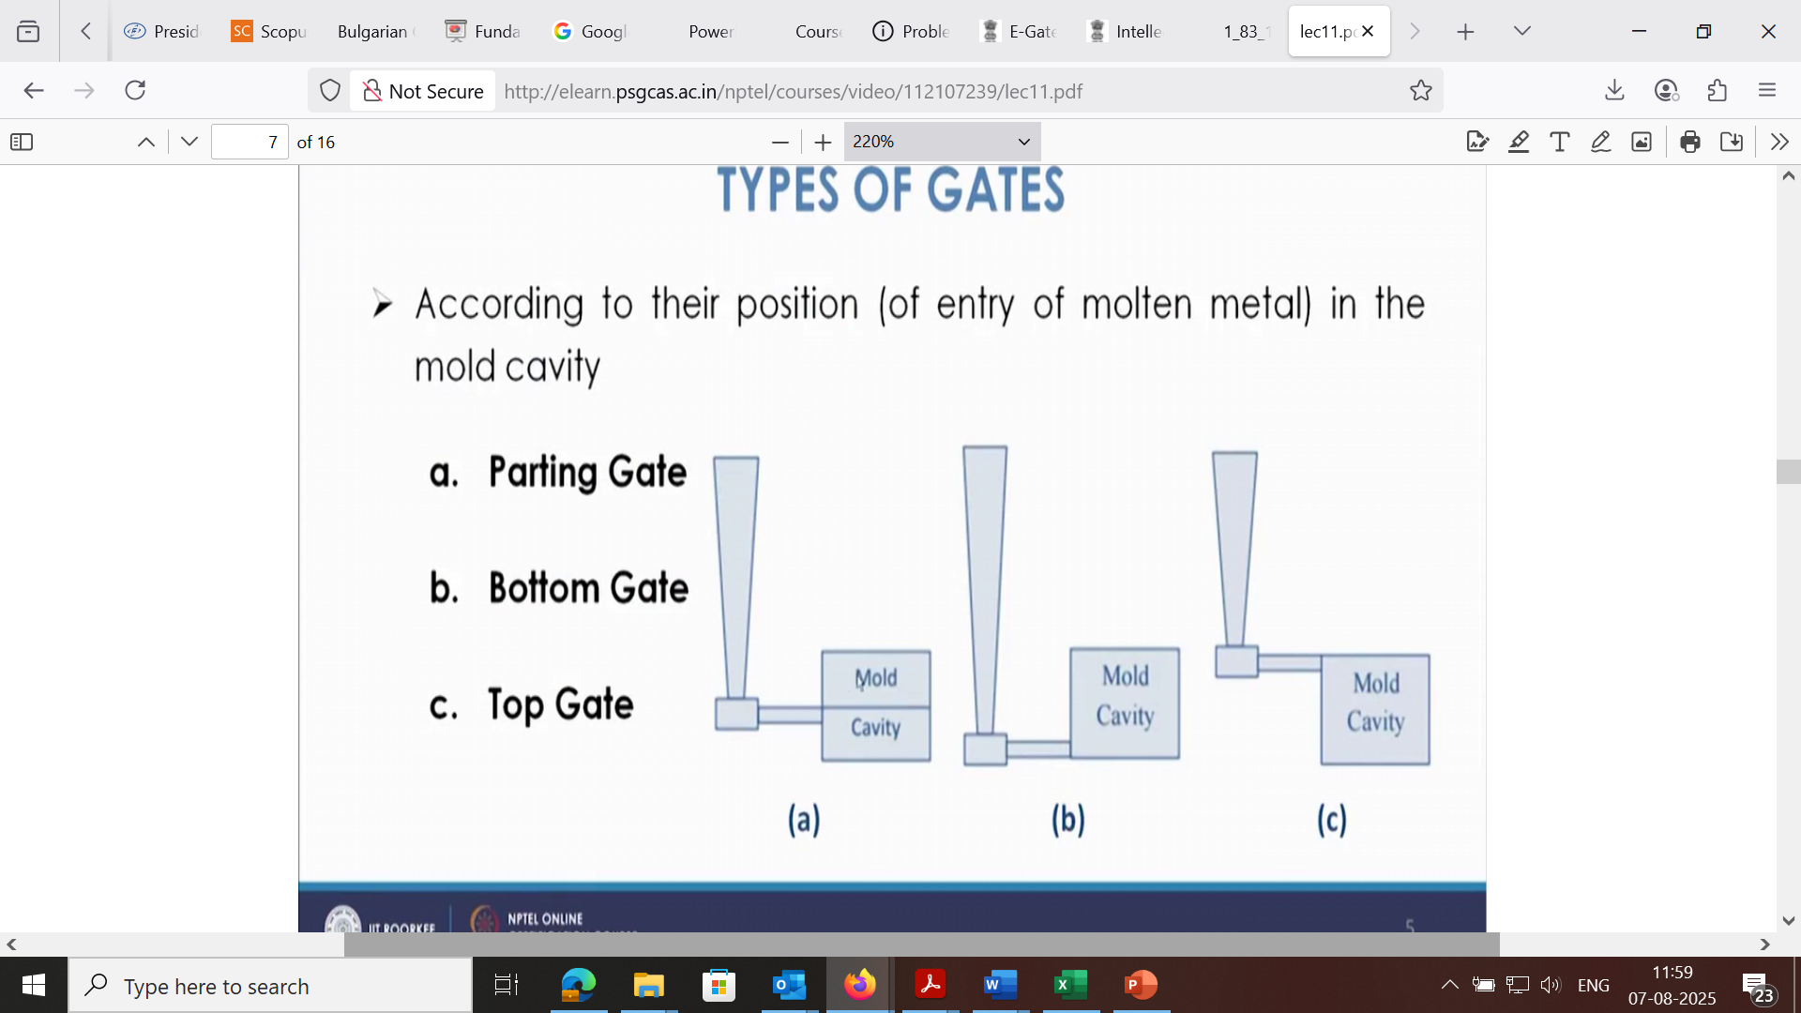
Types of gate
Top Gate:
Molten metal enters the mold cavity from the top. This method is simple but can cause turbulence and erosion.

Slide 11
Types of gates
Bottom Gate:
Molten metal enters the mold cavity from the bottom. This can lead to temperature variations within the casting, with the bottom being hotter and the top cooler.

Slide 12
Types of gate
Parting Line Gate:
Molten metal enters the mold cavity at the parting line, where the two halves of the mold meet. It's a simple and cost-effective method, but can be prone to erosion and dross formation

Slide 13
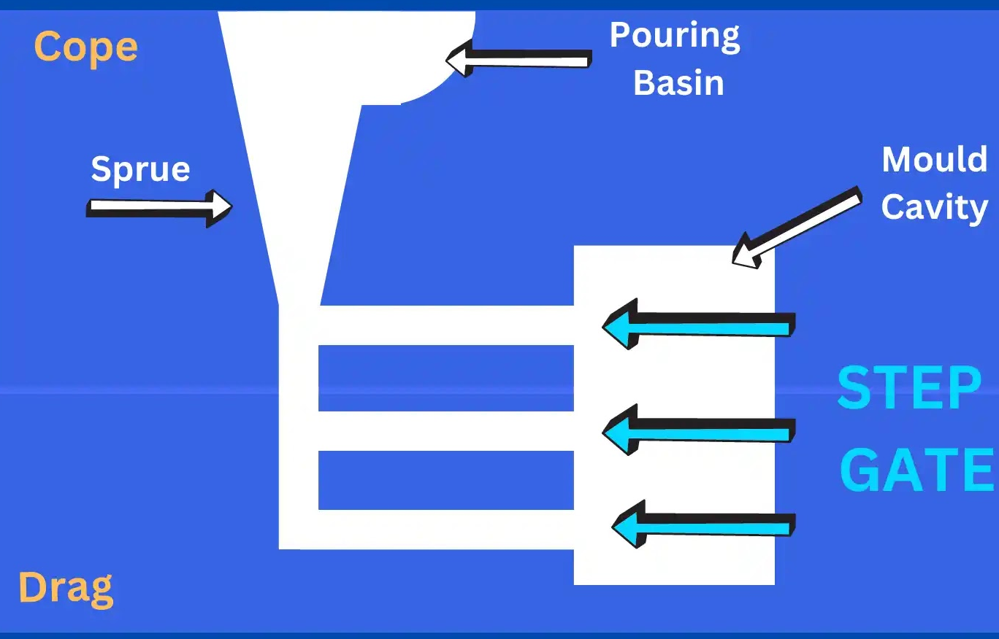
Types of gate
Step Gate:
A step gate is used in the sand casting process for producing heavy casting of large size.
A step gate is used when the molten metal requirement is large and metal needs to fill the mould cavity in steps using the gate.

Slide 14
Gating System parts
Pouring Basin: A funnel-shaped reservoir at the top of the mold (sprue hole) where molten metal is initially poured from crucible.
Sprue: The vertical channel that connects the pouring basin to the runner system and control the flow rate of the metal.
Sprue Well: A small reservoir at the bottom of the sprue, which regulates the flow of metal into the runner and reduces turbulence.
Runner: The horizontal channel(s) that distribute the molten metal from the sprue to the gates.
Runner Extension: An elongated part of runner, used to feed multiple gates or collection place for impurities.
In-gate (or Gate): End opening through which molten metal enters the mold cavity.

Slide 15
Riser
Riser acts as a metal reservoir which holds extra molten metal, which ensures flow of metal into the mold cavity during casting material shrinks.
Riser should be the last part of the mold to solidify, which ensures the continuous feeding of metal until the complete casting is solidified.
It provides shrinkage compensation of molten metal, without which shrinkage would create voids or porosity within the casting.
It prevents defects by preventing shrinkage cavities and maintaining the desired shape and dimensions.

Slide 16


